Slide 1

Unrolling the shutter:
CNN to correct motion distortions
Vijay Rengarajan, Yogesh Balaji, A.N. Rajagopalan
Indian Institute of Technology Madras
Image Processing and Computer Vision lab, Department of Electrical Engineering, IIT Madras

Slide 2
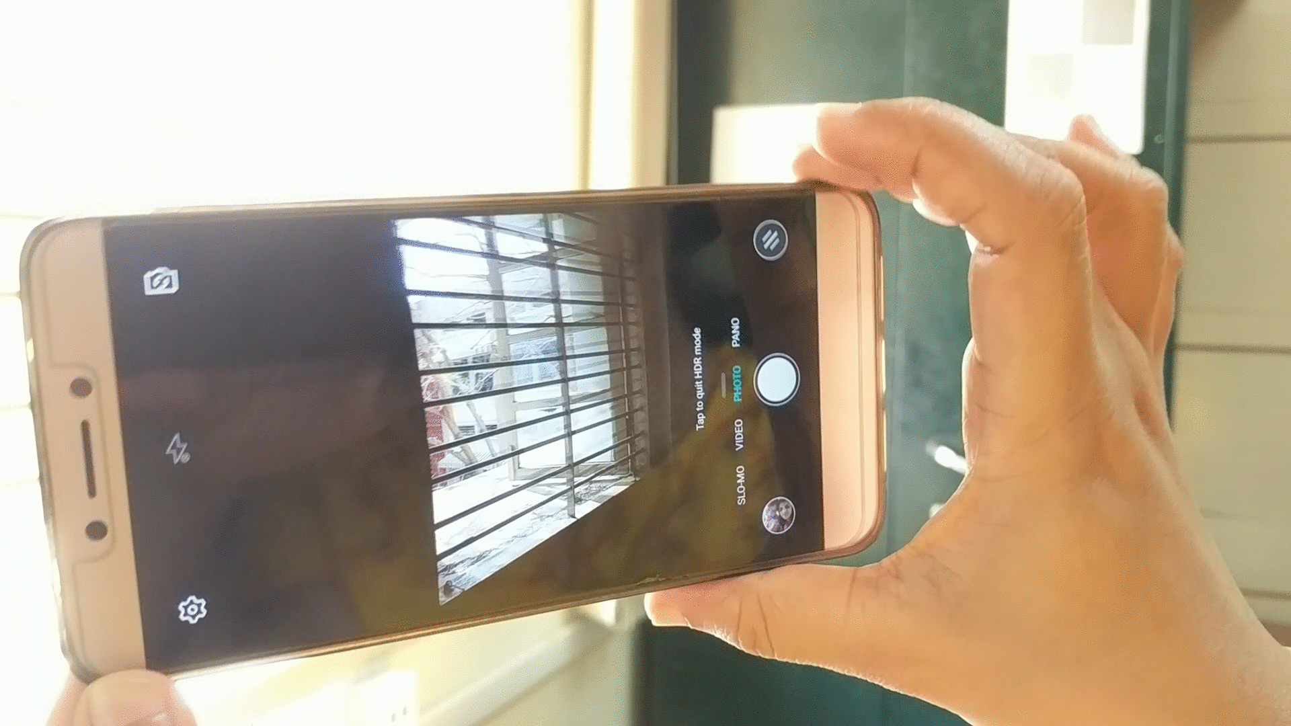

Camera Motion Causes Rolling Shutter Distortions
Motion blur
Lens distortions
Mobile phones
Drone cameras
Streetview capture

Slide 3
Sequential Exposure of Rolling Shutter
Exposure time
t_{e}
Global shutter CCD image sensor
Top row
0
time
All pixels expose at the same time
Bottom row
Exposure open
Exposure close
0
t_{e}
Top row
time
Each row starts exposing sequentially
Bottom row
T_{d}
Total line delay
Rolling shutter CMOS image sensor

Slide 4
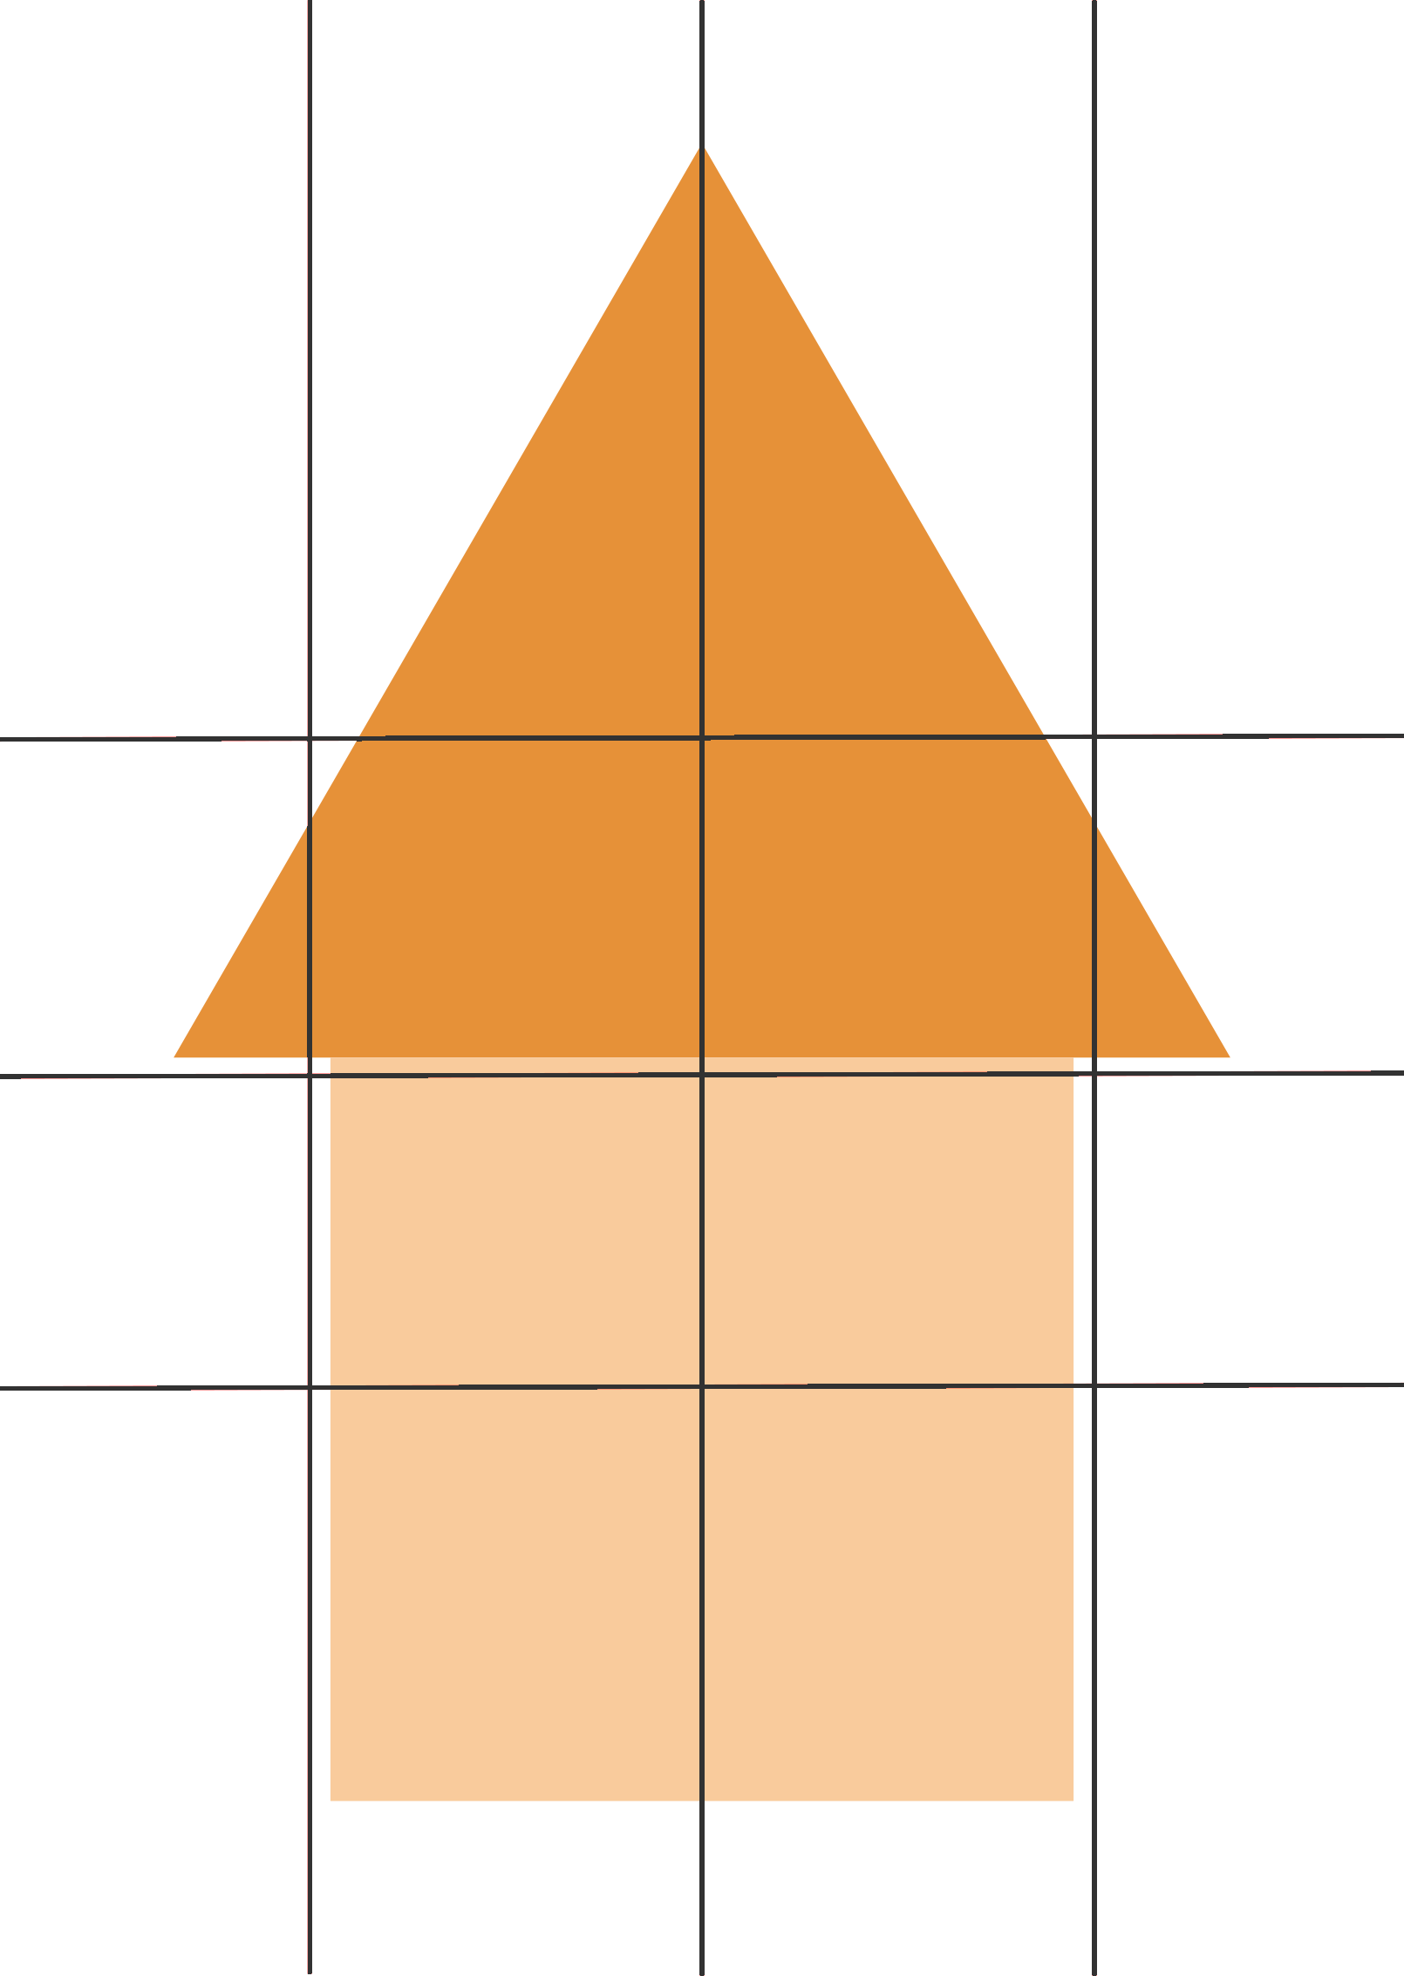
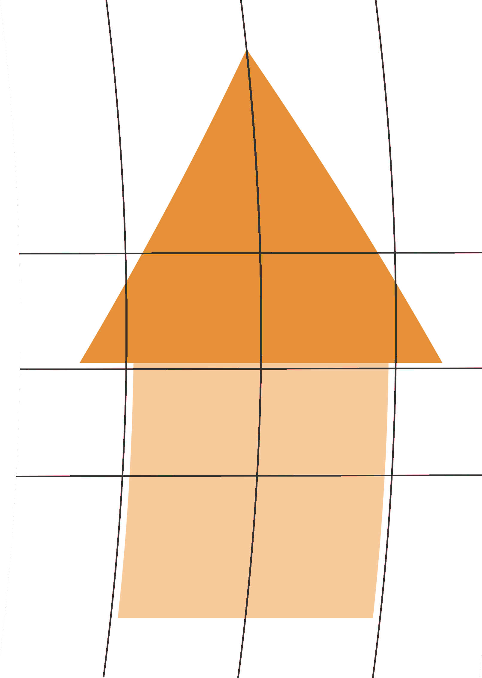
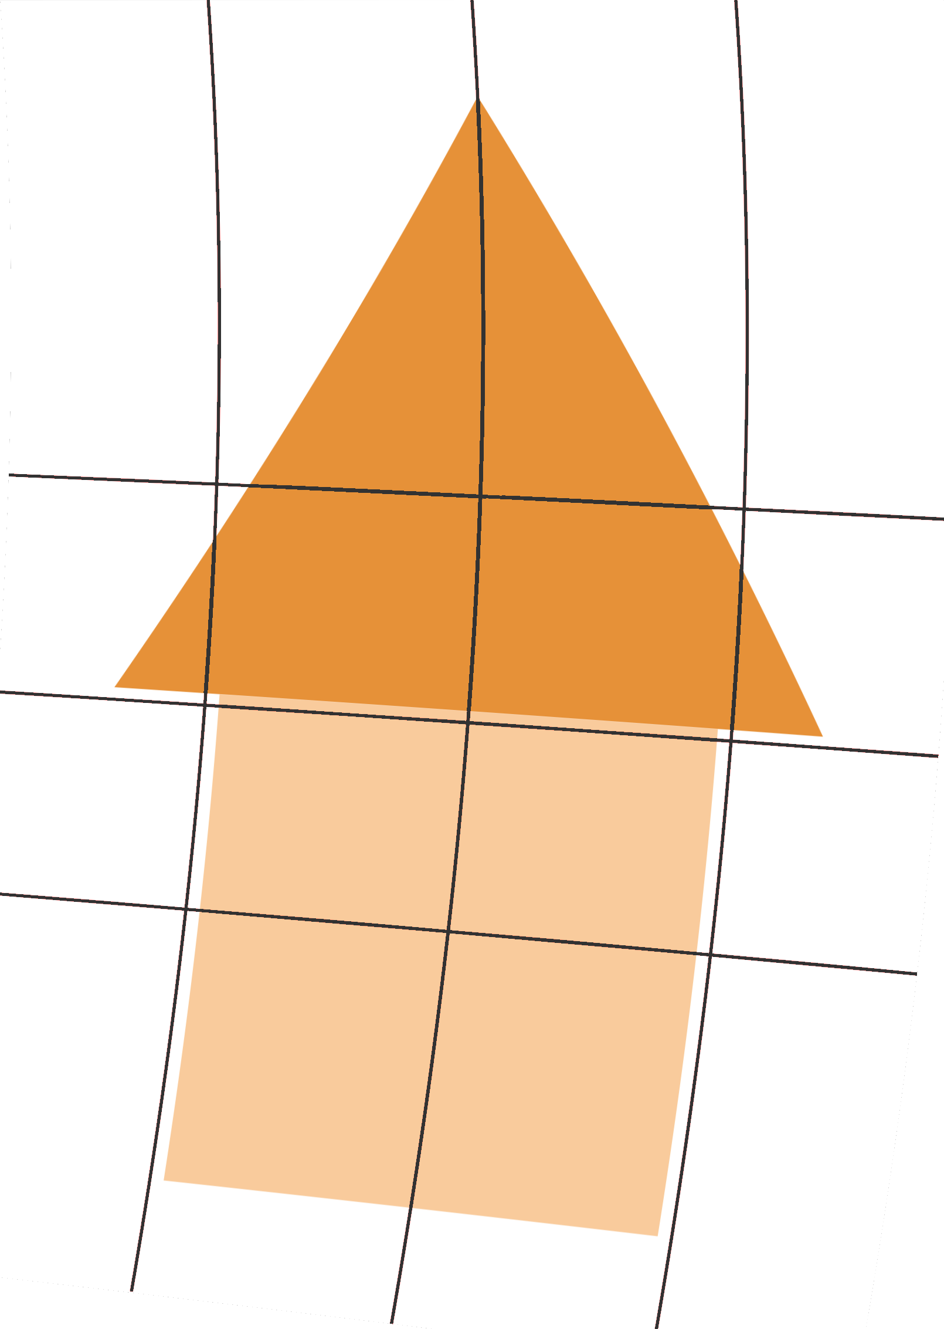
Rolling Shutter Distortions are Geometric
Different rows see the scene at different poses of the moving camera
Even short exposure causes distortions
Scene
Scene
r_{z} rotation
z
z
x
x
y
t_{x} translation
y
time
time
Captured image
Captured image

Slide 5
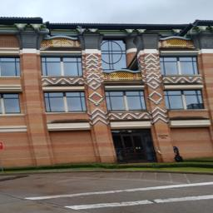
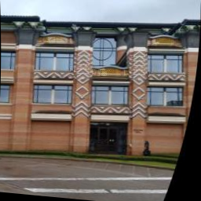


Correct Rolling Shutter Distortions from a Single Image
Disturbs visual appeal
Affects scene inference
Single image ambiguity
curved building or rolling shutter effect?

Slide 6
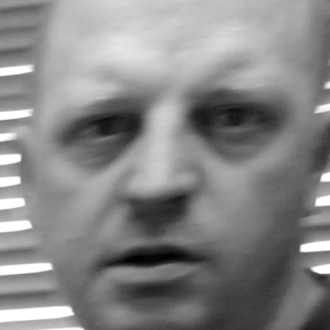
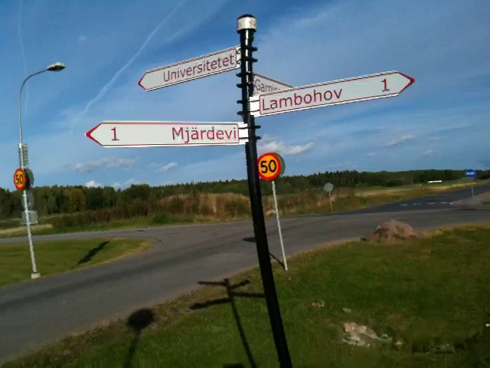
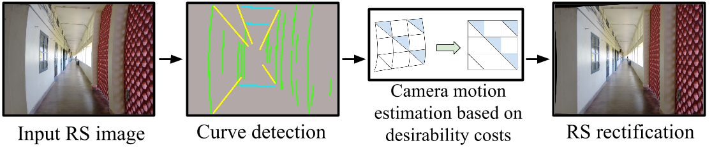
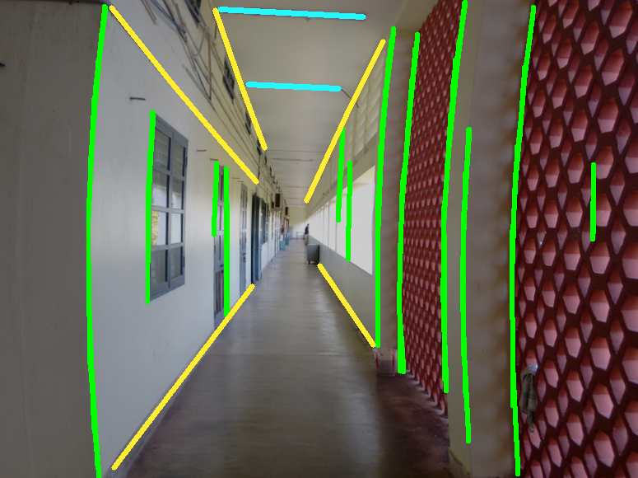
Prior Works on Rolling Shutter Correction
Heflin et al. Conf. Biometrics (2010) for faces
Video rolling shutter correction
Need
A single method that can be used for different classes of images
Different levels of features to correct extract motion and to discard feature outliers
Rolling shutter
Corrected using facial features
Rengarajan et al. CVPR (2016) for urban scenes
Ringaby and Forssen
CVPR (2010)
IJCV (2012)
Grundmann et al.
ICCP (2012)
Use frame-to-frame point correspondences
Rolling shutter
Curvatures
Corrected

Slide 7
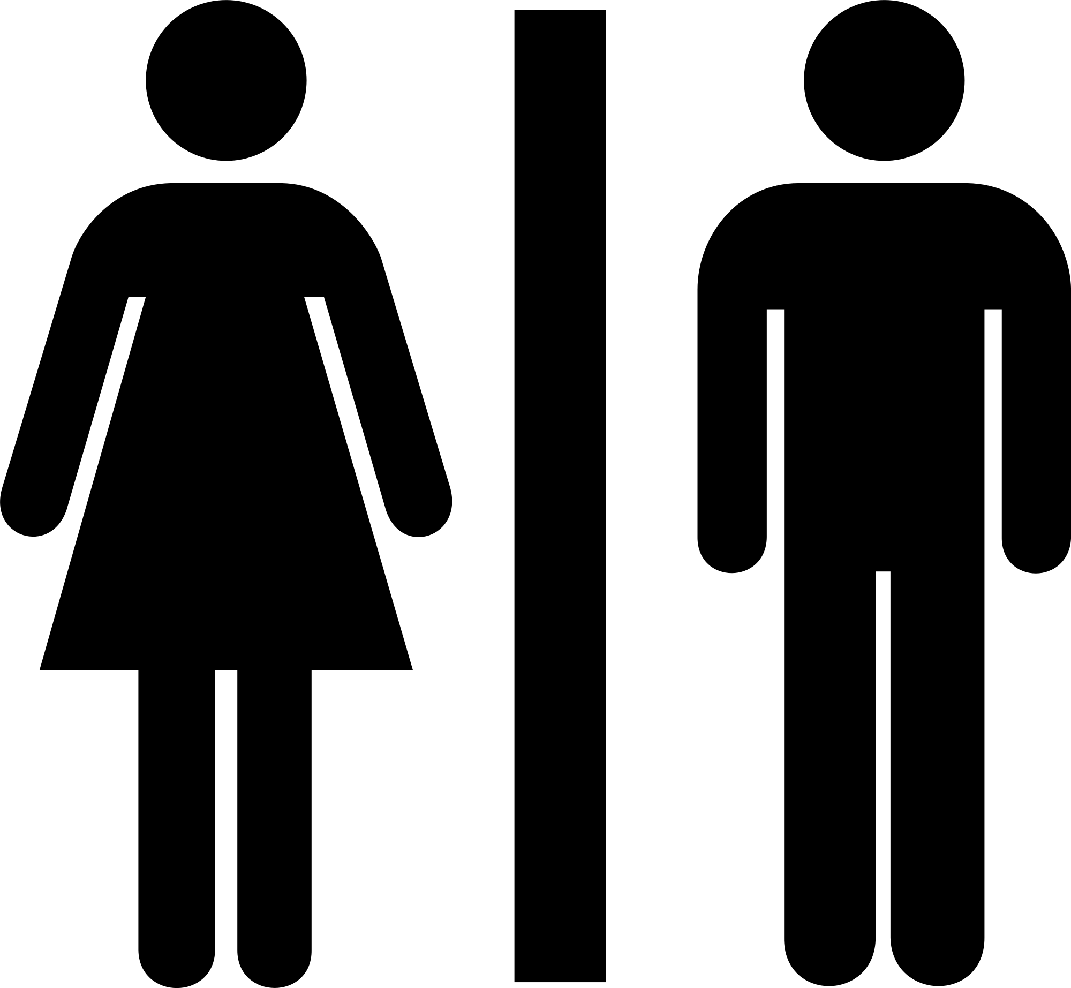

Let machines extract desired features
Existing approach
Corrected Image
Rolling shutter distorted image
Corrected Image
Rolling shutter distorted image
Feature Extraction
Motion Fitting
Distortion Correction
CNN
Motion Estimation
Distortion Correction
1
2
Convolutional Neural Network
Input Rolling shutter image 256x256x3
Output Translation and rotation (tx,rz)
15 tx and 15 rz motion samples of
equally spaced rows
Train for different classes of images
Motion fitting
Polynomial trajectory to get tx and rz for each row
3
Distortion correction
Inverse warping based on row-wise motion

Slide 8
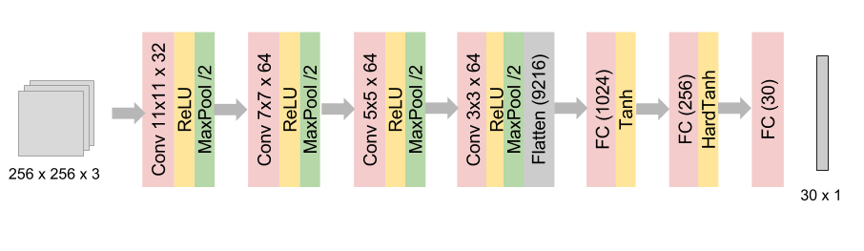
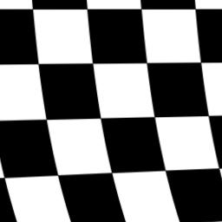
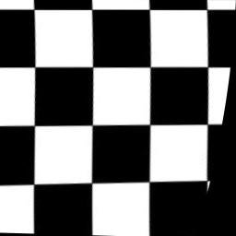
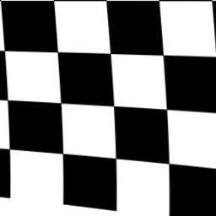
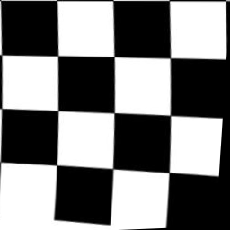
VanillaCNN with square filters
Motion Mean Squared Error
t_{x} and r_{z} at 15 rows
Vanilla Convolutional Neural Network
VanillaCNN
1
2
Translations only
Translations and rotations
Distorted image
Corrected by
VanillaCNN
Distorted image
Corrected by
VanillaCNN

Slide 9
Ideas for a new architecture
Initial feature extraction
Feature combination
Any better ideas?
Along rows : motion constancy
Along columns : temporal motion
Notes:
Rotation can be better estimated if information from image rows are extracted earlier

Slide 10
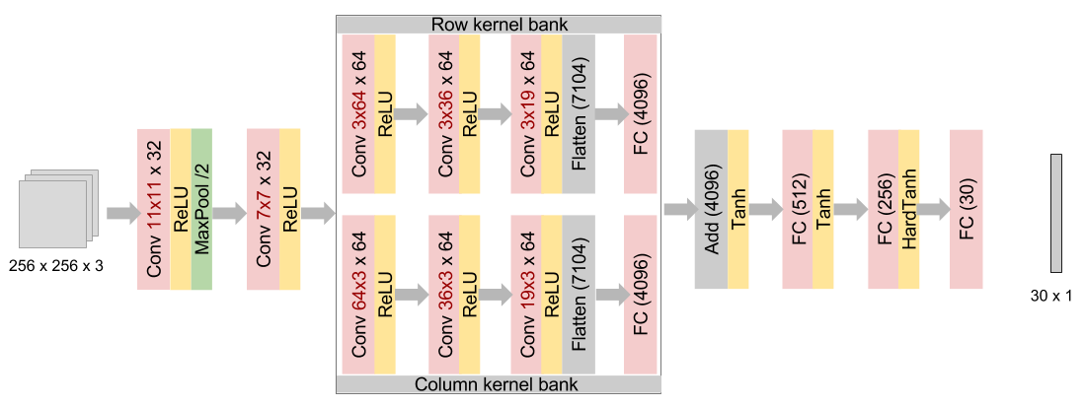
Use long filters for RowColCNN
Captures information in rows early
Motion Mean Squared Error
Filter h x w x c
Captures information along time dimension early

Slide 11
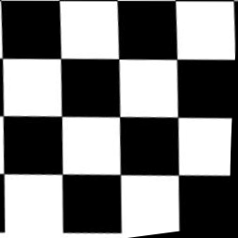
Use long filters for RowColCNN
Captures information along row dimension early
    Training Data Generation
      Generate random polynomial camera trajectory
      Apply on undistorted image
    Datasets
      Chessboard Urban scenes Faces
      7k 300k 250k
      Sun Oxford Zurich LFW
    Correction
      Get camera motion values from CNN
      Fit a polynomial trajectory and get motion at all rows
      Correct distorted image using target-to-source mapping
Motion Mean Squared Error
Corrected by
VanillaCNN
Corrected by
RowColCNN
Captures information along time dimension early
Notes:
The datasets do not have rolling shutter effect. We synthetically generate them. Even so, it works for real images that we captured using mobile phones.

Slide 12
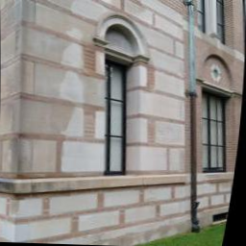
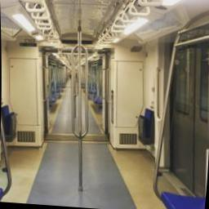
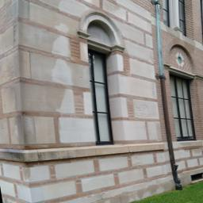
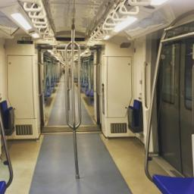
Correction Results of RowColCNN

Slide 13
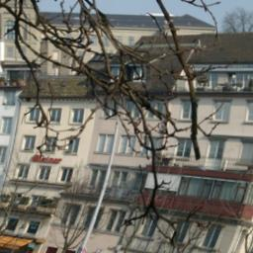
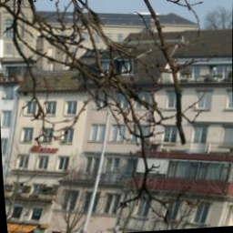
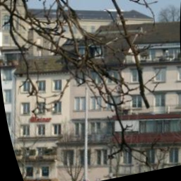
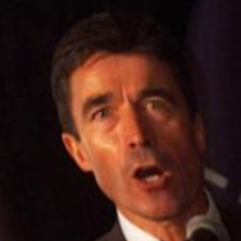
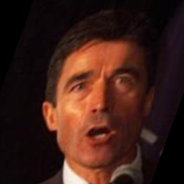
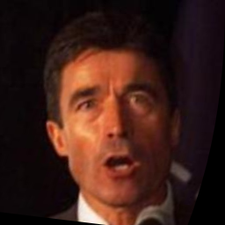
Learning excels in challenging conditions
Distorted input
Geometry-based
Learning-based
Rengarajan et al. (2016) fail due to tree branches which are naturally curved
Rengarajan et al. 2016
RowColCNN
Heflin et al. (2010) fail due to wrong estimation of facial features in varied illumination conditions
Heflin et al. 2010
RowColCNN

Slide 14

New CNN filter shapes inspired by application
New learning-based method for single image rolling shutter correction
CNN learns image to motion mapping
Long filters in CNN architecture for rolling shutter exposure
Poster 21 AM
apvijay.github.io/rs_rect_cnn

